Slide 1
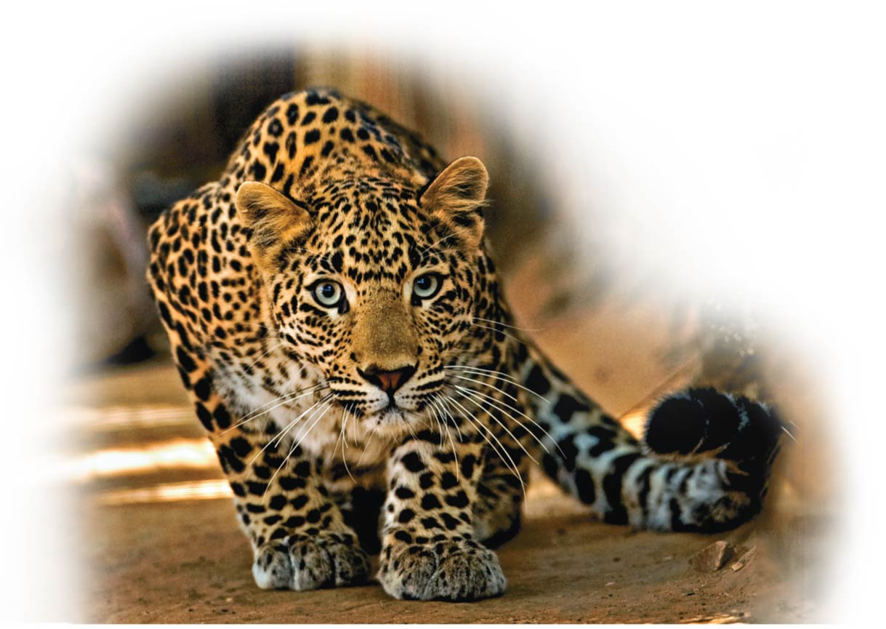
Cellular Respiration: Obtaining Energy from Food
Unit 1; Chapter 6

Slide 2
Biology and Society: Getting the Most Out of Your Muscles
For many endurance athletes, the rate at which oxygen is provided to working muscles is the limiting factor in their performance.
Your muscles need a continuous supply of energy to perform work.
Muscle cells obtain this energy from the sugar glucose through a series of chemical reactions that depend upon a constant input of oxygen (O₂).
When there is enough oxygen reaching your cells to support their energy needs, metabolism（新陈代谢） is said to be aerobic（有氧的）.
aero = air (aerobic: chemical reaction using oxygen)
Notes:
2

Slide 3
Biology and Society: Getting the Most Out of Your Muscles
Your aerobic capacity is
the maximum rate at which O₂ can be taken in and used by your muscle cells and
therefore the most strenuous exercise that your body can maintain aerobically.
Notes:
3

Slide 4
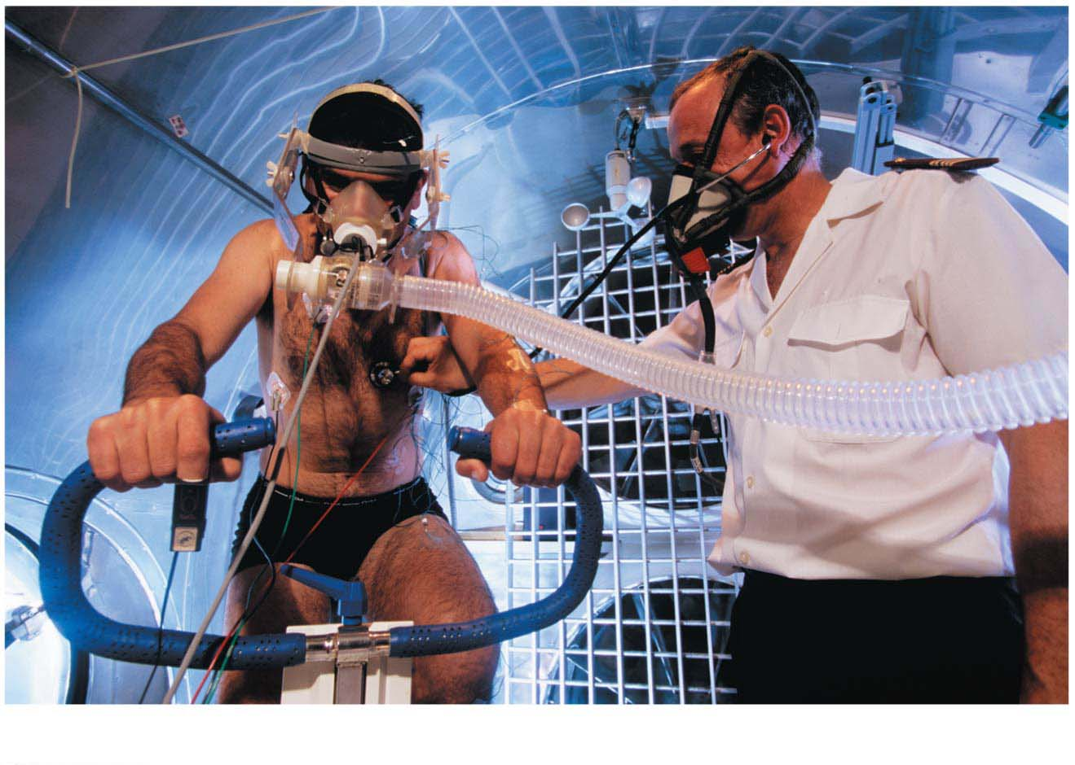
Figure 6.0-2
Chapter Thread: Exercise Science
Notes:
Figure 6.0-2 Exercise science: the science of exercise

Slide 5
Biology and Society: Getting the Most Out of Your Muscles
If you work even harder and exceed your aerobic capacity,
the demand for oxygen in your muscles will outstrip your body’s ability to deliver it,
metabolism then becomes anaerobic（无氧的）, and
your muscle cells switch to an “emergency mode” in which they
break down glucose very inefficiently and
produce lactic acid（乳酸） as a by-product.
Notes:
5

Slide 6
Biology and Society: Getting the Most Out of Your Muscles
Every living organism depends on processes that provide energy.
Cells harvest food energy and put it to work with the help of oxygen.
Notes:
6

Slide 7
Energy Flow and Chemical Cycling in the Biosphere
All life requires energy!
In almost all ecosystems on Earth, this energy originates with the sun.
During photosynthesis, plants convert the energy of sunlight to the chemical energy of sugars and other organic molecules.
Humans and other animals depend on this conversion for food and more.
Notes:
7

Slide 8
Producers and Consumers
Plants and other autotrophs（自养生物） (“self-feeders”) are organisms that make all their own organic matter, including carbohydrates, lipids, proteins, and nucleic acids, from nutrients that are entirely inorganic:
carbon dioxide from the air and water and
minerals from the soil.
Heterotrophs（异养生物） (other-feeders)
include humans and other animals and
cannot make organic molecules from inorganic ones.
autotroph: auto = self, troph = food (organism that makes its own organic matter)
heterotroph: hetero = other (an organism that cannot make its own organic foods
from inorganic ingredients)
Notes:
8

Slide 9
Producers and Consumers
Most ecosystems depend entirely on photosynthesis for food.
Biologists refer to
plants and other autotrophs as producers and
heterotrophs, in contrast, as consumers, because they obtain their food by eating plants or by eating animals that have eaten plants.
Notes:
9

Slide 10
Chemical Cycling between Photosynthesis and Cellular Respiration
The chemical ingredients for photosynthesis are carbon dioxide (CO₂) and water (H₂O).
CO₂ passes from the air into a plant via tiny pores.
H₂O is absorbed from the soil by the plant’s roots.
Notes:
10

Slide 11
Chemical Cycling between Photosynthesis and Cellular Respiration
Inside leaf cells, tiny structures called chloroplast（叶绿体） use light energy to rearrange the atoms of these ingredients to produce sugars, most importantly glucose (C₆H₁₂O₆), and other organic molecules.
A by-product of photosynthesis is oxygen gas (O₂).
Notes:
11

Slide 12
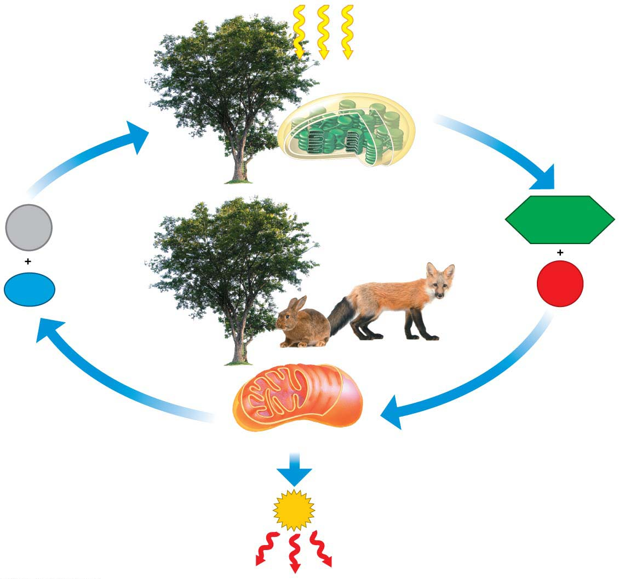
Sunlight energy
enters ecosystem
Photosynthesis
CO₂
C₆H₁₂O₆
H₂O
O₂
Cellular respiration
ATP
drives cellular work
Heat energy exits ecosystem
Notes:
Figure 6.2 Energy flow and chemical cycling in ecosystems

Slide 13
Chemical Cycling between Photosynthesis and Cellular Respiration
Both animals and plants use the organic products of photosynthesis as sources of energy.
A chemical process called cellular respiration harvests energy that is stored in sugars and other organic molecules.
Notes:
13

Slide 14
Chemical Cycling between Photosynthesis and Cellular Respiration
Cellular respiration uses O₂ to help convert the energy stored in the chemical bonds of organic fuels to another source of chemical energy called ATP.
Cells use ATP for almost all their work.
In plants and animals, the production of ATP during cellular respiration occurs mainly in organelles called mitochondria（线粒体）.
Notes:
14

Slide 15
Chemical Cycling between Photosynthesis and Cellular Respiration
The waste products of cellular respiration are CO₂ and H₂O, the very same ingredients used for photosynthesis.
Plants
store chemical energy via photosynthesis and then
harvest this energy via cellular respiration.
Notes:
15

Slide 16
Chemical Cycling between Photosynthesis and Cellular Respiration
Plants usually make more organic molecules than they need for fuel.
This photosynthetic surplus
provides material for the plant to grow or
can be stored, as starch（淀粉） in potatoes, for example.
People have always taken advantage of plants’ photosynthetic abilities by eating them.
Notes:
16

Slide 17
Cellular Respiration: Aerobic Harvest of Food Energy
Cellular respiration is
aerobic harvesting of chemical energy from organic fuel molecules,
the main way that chemical energy is harvested from food and converted to ATP, and
an aerobic process—it requires oxygen.
Notes:
17
Cellular respiration is aerobic, which is just another way of saying that it requires oxygen.

Slide 18
Cellular Respiration: Aerobic Harvest of Food Energy
It requires that a cell exchange two gases with its surroundings.
The cell takes in oxygen in the form of the gas O₂.
It gets rid of waste in the form of the gas carbon dioxide, or CO₂.
Notes:
18

Slide 19
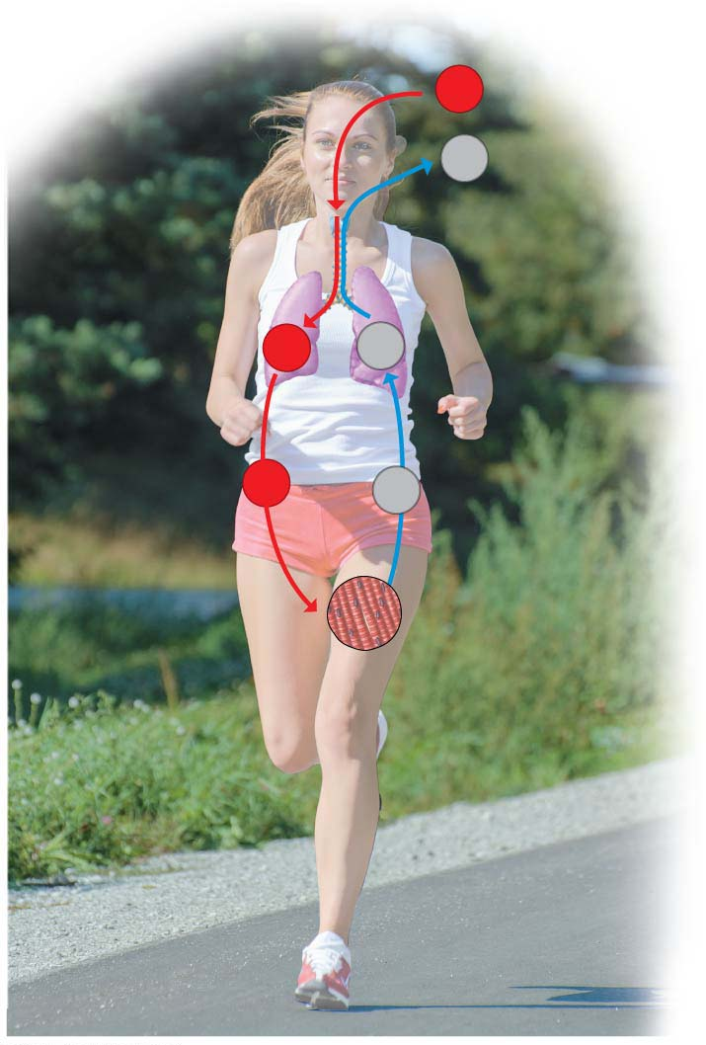
O₂
CO₂
Lungs
O₂
CO₂
O₂
CO₂
Muscle cells
Cellular
respiration
Notes:
Figure 6.3 How breathing is related to cellular respiration

Slide 20
Energy Transformations: An Overview of Cellular Respiration
One of biology’s overarching themes is that all life depends on transformations of energy and matter.
Few are as important as the conversion of energy in fuel (food molecules) to a form that cells can use directly.
Most often, the fuel molecule used by cells is glucose, a simple sugar (monosaccharide（单糖）) with the formula C₆H₁₂O₆.
Notes:
20

Slide 21
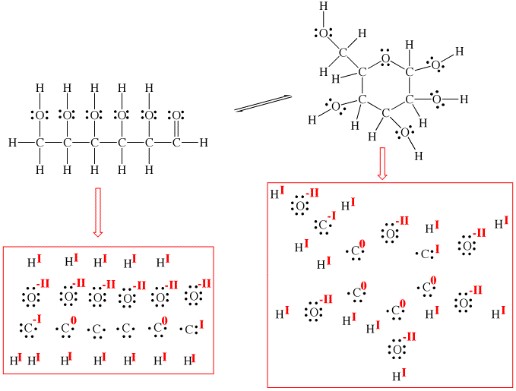
~32
C₆H₁₂O₆
6
O₂
6
CO₂
6
H₂O
ATP
Notes:
Figure 6.UN05 Summary of key concepts: cellular respiration equation

Slide 22
Energy Transformations: An Overview of Cellular Respiration
Cellular respiration
consists of many chemical steps, with more than two dozen reactions in all,
involves a specific enzyme to catalyze each reaction,
constitutes one of the most important metabolic pathways for nearly every eukaryotic cell, and
provides the energy these cells need to maintain the functions of life.
Notes:
22

Slide 23
Energy Transformations: An Overview of Cellular Respiration
The many chemical reactions that make up cellular respiration can be grouped into three main stages:
glycolysis,
the citric acid cycle（三羧酸循环）, and
electron transport
Notes:
23

Slide 24
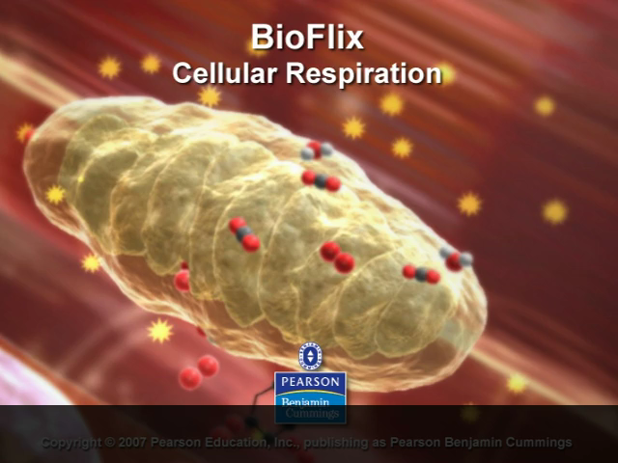
BioFlix Animation: Cellular Respiration

Slide 25
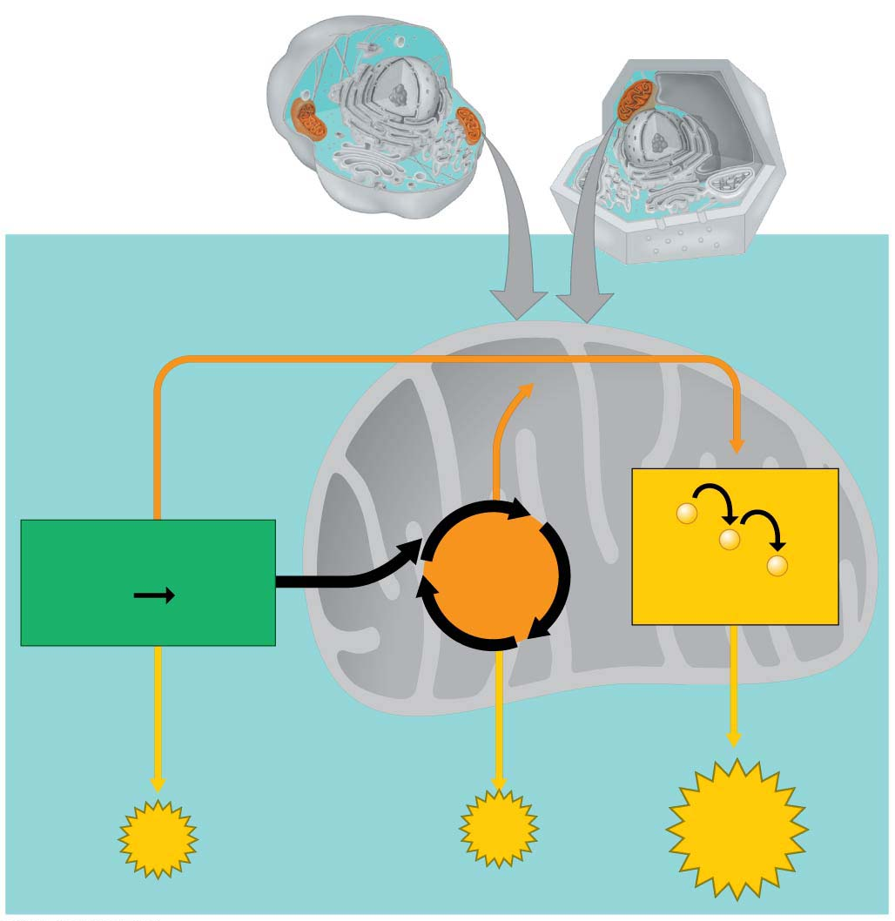
Mitochondria
Cytoplasm
Cytoplasm
Animal cell
Plant cell
Cytoplasm
Mitochondrion
High-energy
electrons
via carrier
molecules
NADH
NADH
FADH2
−
Glycolysis
Citric
Acid
Cycle
−
2
Pyruvic
acid
−
Glucose
Electron
Transport Chain
CO2
ATP
ATP
ATP
Notes:
Figure 6.4 A road map for cellular respiration

Slide 26
Energy Transformations: An Overview of Cellular Respiration
During glycolysis（糖酵解）, a molecule of glucose is split into two molecules of a compound called pyruvic acid（丙酮酸）, usually located in the cytoplasm.
The citric acid cycle (also called the Krebs cycle)
uses enzymes that are dissolved in the fluid within mitochondria and
completes the breakdown of glucose all the way to CO₂, which is then released as a waste product.
Notes:
26

Slide 27
Energy Transformations: An Overview of Cellular Respiration
1 and 2. Glycolysis and the citric acid cycle generate a small amount of ATP directly and much more ATP indirectly, via reactions that transfer electrons from fuel molecules to a molecule called NAD⁺ (nicotinamide adenine dinucleotide（烟酰胺腺嘌呤二核苷酸; 辅酶）).
The electron transfer forms a molecule called NADH, which acts as a shuttle carrying high-energy electrons from one area of the cell to another.
Notes:
27
NAD+ to NADH.

Slide 28
Energy Transformations: An Overview of Cellular Respiration
The third stage of cellular respiration is electron transport.
Electrons captured from food by NADH are stripped of their energy, a little bit at a time, until they are finally combined with oxygen to form water.
The proteins and other molecules that make up electron transport chains are embedded within the inner membrane of the mitochondria.
Electron transport from NADH to oxygen releases the energy your cells use to make most of their ATP.
Notes:
28

Slide 29
Energy Transformations: An Overview of Cellular Respiration
The overall equation for cellular respiration shows that the atoms of the reactant molecules glucose and oxygen are rearranged to form the products carbon dioxide and water.
The main function of cellular respiration is to generate ATP for cellular work.
The process can produce around 32 ATP molecules for each glucose molecule consumed.
Notes:
29

Slide 30
The Three Stages of Cellular Respiration
Stage 1: Glycolysis
During glycolysis
A six-carbon glucose molecule is split in half to form two molecules of pyruvic acid.
The three-carbon molecules then donate high-energy electrons to NAD⁺,
forming NADH, and
generate four ATP molecules directly when enzymes transfer phosphate groups from fuel molecules to ADP.
Notes:
30

Slide 31
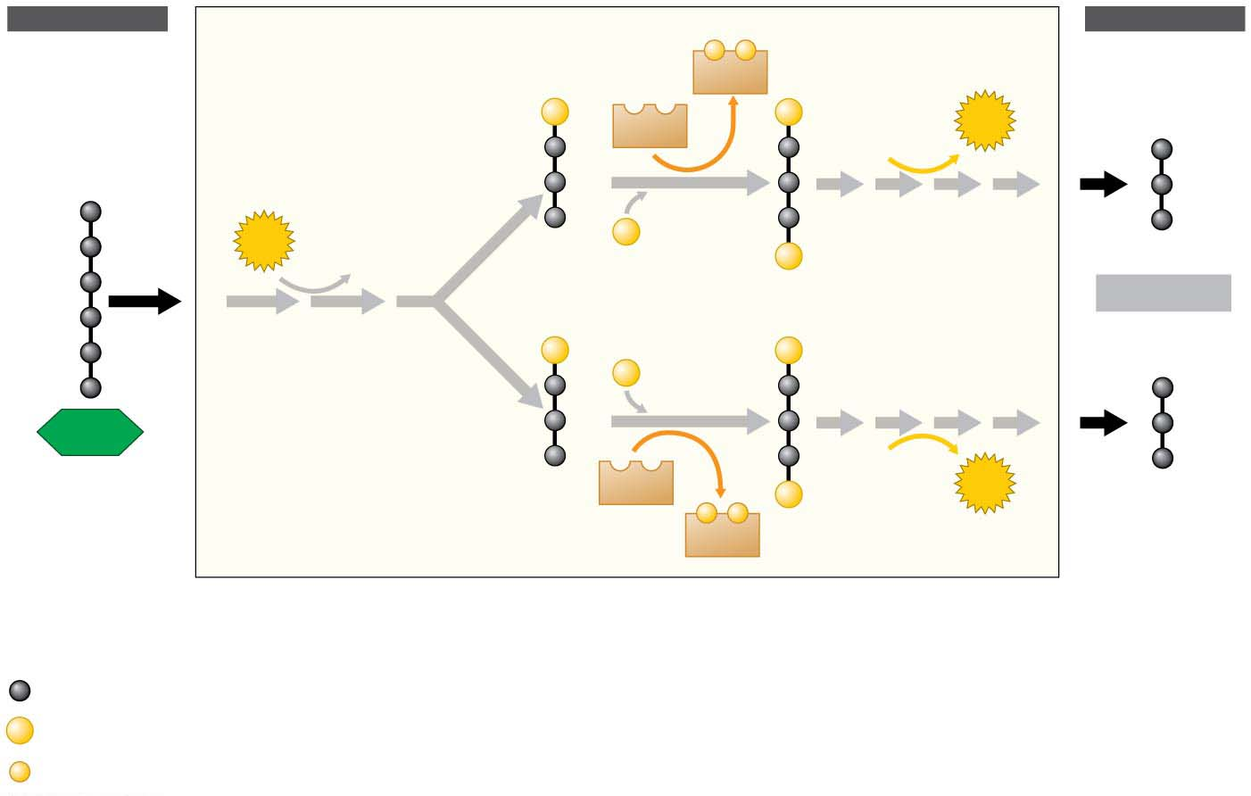
INPUT
OUTPUT
−
−
NADH
P
NAD⁺
P
2
ATP
ADP
2
2
3
P
3
2
ATP
ADP
2
2
P
2 Pyruvic acid
1
P
P
P
2
2
3
3
Glucose
1
ADP
2
2
ATP
NAD⁺
P
−
−
NADH
Key
Energy investment phase
Energy harvest phase
Carbon atom
P
Phosphate group
−
High-energy electron
Notes:
Figure 6.5 Glycolysis

Slide 32
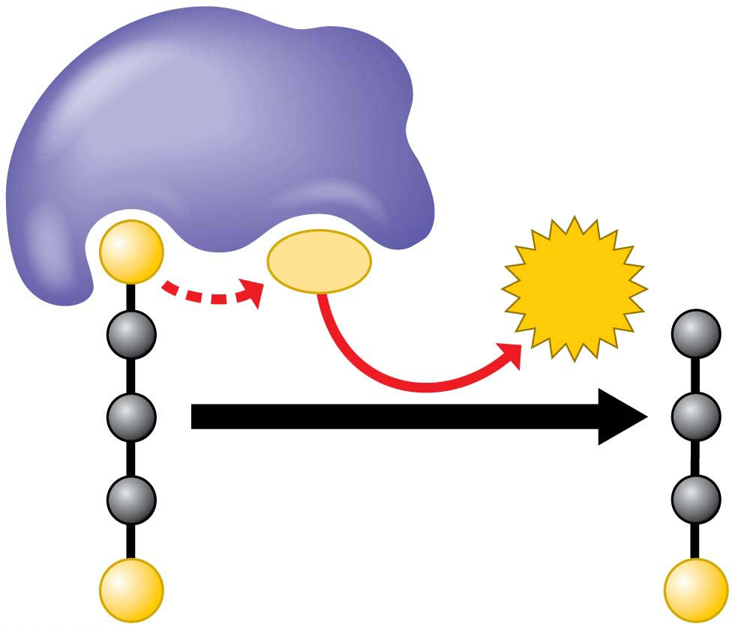
Enzyme
P
ADP
ATP
P
P
ATP synthesis by direct phosphate transfer
Notes:
Figure 6.6 ATP synthesis by direct phosphate transfer

Slide 33
Stage 2: The Citric Acid Cycle
The pyruvic acid must be converted to a form the citric acid cycle can use.
Each pyruvic acid loses a carbon as CO₂.The remaining fuel molecules, with only two carbons left, are called acetic acid（乙酸）.
Electrons are stripped from these molecules and transferred to another molecule of NAD⁺, forming more NADH.
Finally, each acetic acid is attached to a molecule called coenzyme A（辅酶A） (CoA) to form acetyl CoA(乙酰辅酶A). The CoA escorts the acetic acid into the first reaction of the citric acid cycle and is then stripped and recycled.
Notes:
33

Slide 34
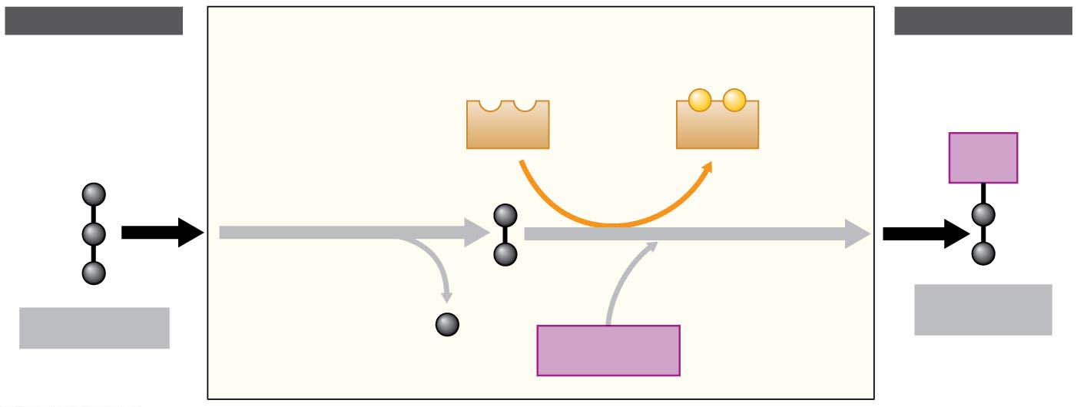
The link between glycolysis and the citric acid cycle: The conversion of pyruvic acid to acetyl CoA
INPUT
OUTPUT
(from
glycolysis)
2
Breakdown of the fuel
generates NADH
(to citric
acid cycle)
−
−
NAD⁺
NADH
CoA
1
Pyruvic acid
loses a carbon
as CO₂
Acetic
acid
3
Acetic acid
attaches to
coenzyme A
Pyruvic acid
Acetyl CoA
CO₂
Coenzyme A
Acetic acid
Notes:
Figure 6.7 The link between glycolysis and the citric acid cycle: the conversion of pyruvic acid to acetyl CoA

Slide 35
Stage 2: The Citric Acid Cycle
The citric acid cycle finishes extracting the energy of sugar by dismantling the acetic acid molecules all the way down to CO₂.
Acetic acid joins a four-carbon acceptor molecule to form a six-carbon product called citric acid (for which the cycle is named).
For every acetic acid molecule that enters the cycle as fuel, two CO₂ molecules eventually exit as a waste product. Along the way, the citric acid cycle harvests energy from the fuel.
Notes:
35

Slide 36
Stage 2: The Citric Acid Cycle
Some of the energy is used to produce ATP directly. However, the cycle captures much more energy in the form of
NADH and a closely related electron carrier called FADH₂.
All the carbon atoms that entered the cycle as fuel are accounted for as CO₂ exhaust, and the four-carbon acceptor molecule is recycled.
Notes:
36

Slide 37
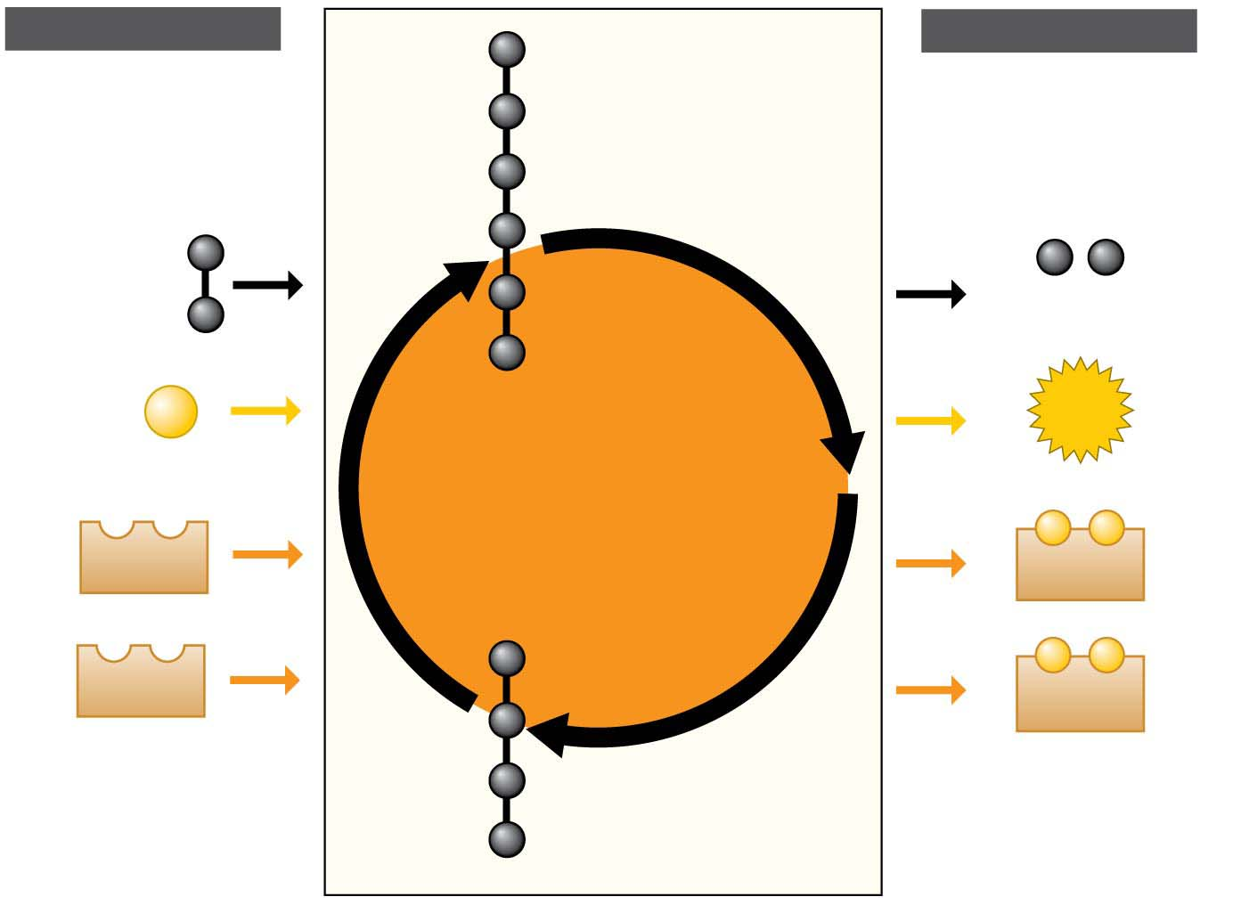
INPUT
OUTPUT
Citric
acid
1
Acetic
acid
2
2
CO₂
Citric
Acid
Cycle
ADP
+
P
ATP
3
−
−
3
NAD⁺
3
NADH
4
−
−
FAD
5
FADH₂
5
6
Acceptor
molecule
Notes:
Figure 6.8 The citric acid cycle

Slide 38
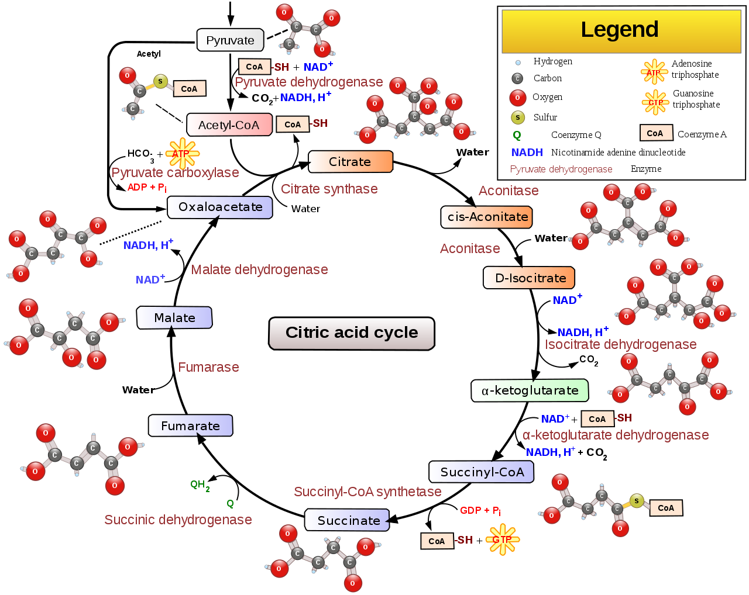
FADH2
FAD
ADP + Pi
ATP

Slide 39
Stage 3: Electron Transport
During cellular respiration, the electrons gathered from food molecules “fall” in a stepwise cascade down an energy staircase, unlocking chemical energy in small amounts, bit by bit, that cells can put to productive use.
The transfer of electrons from organic fuel (food) to NAD⁺ converts it to NADH.
The rest of the staircase consists of an electron transport chain.
Notes:
39

Slide 40
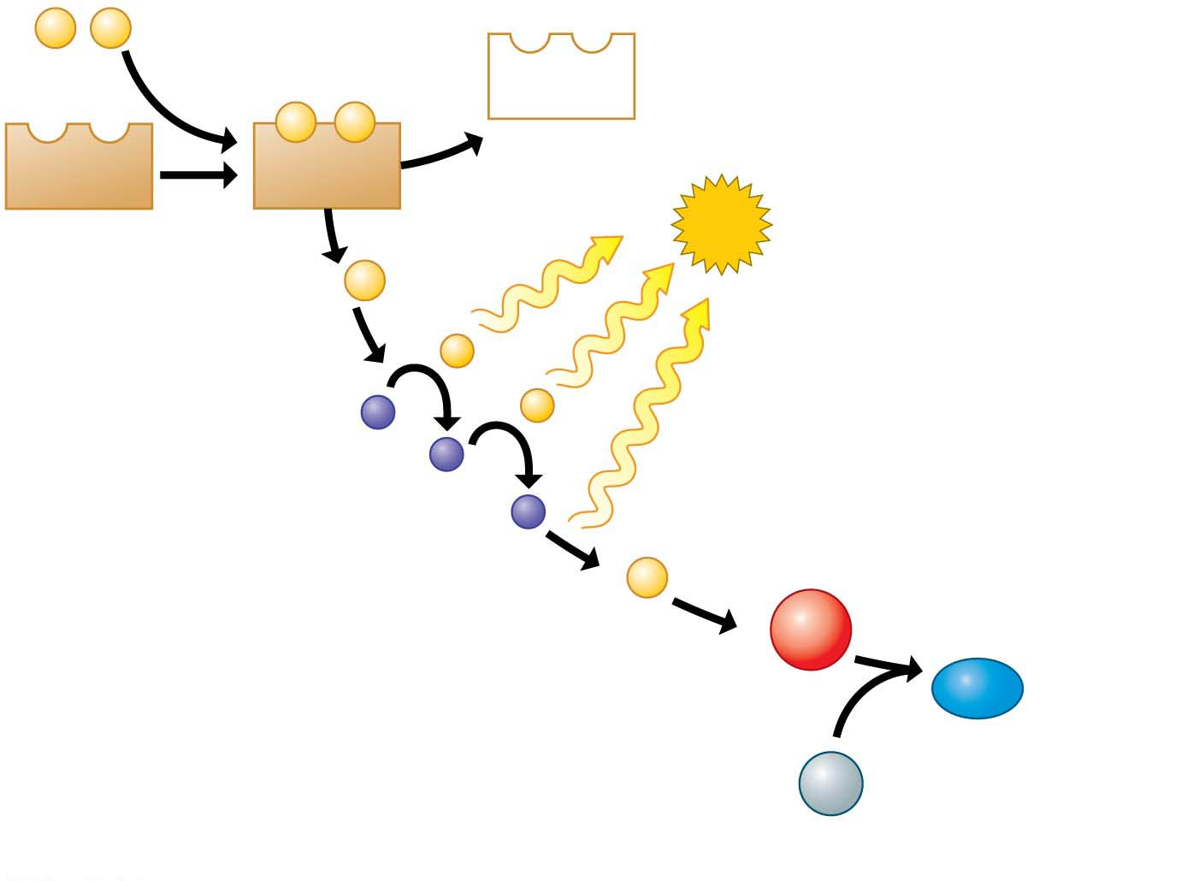
e⁻
e⁻
Electrons from food
NAD⁺
e–
e–
NAD⁺
NADH
Stepwise release
of energy used
to make ATP
ATP
2
e⁻
−
−
Electron
transport
chain
2
e⁻
1
O₂
2
H₂O
Hydrogens,
electrons, and
oxygen combine to
form water
2
H⁺
Notes:
Figure 6.9 The role of oxygen in harvesting food energy

Slide 41
Stage 3: Electron Transport
The overall effect of all this transfer of electrons during cellular respiration is a “downward” trip for electrons
from glucose,
to NADH,
to an electron transport chain, and
to oxygen.
Notes:
41

Slide 42
Stage 3: Electron Transport
The molecules of electron transport chains are built into the inner membranes of mitochondria.
Because these membranes are highly folded, their large surface area can accommodate thousands of copies of the electron transport chain, another good example of how biological structure fits function.
Notes:
42

Slide 43
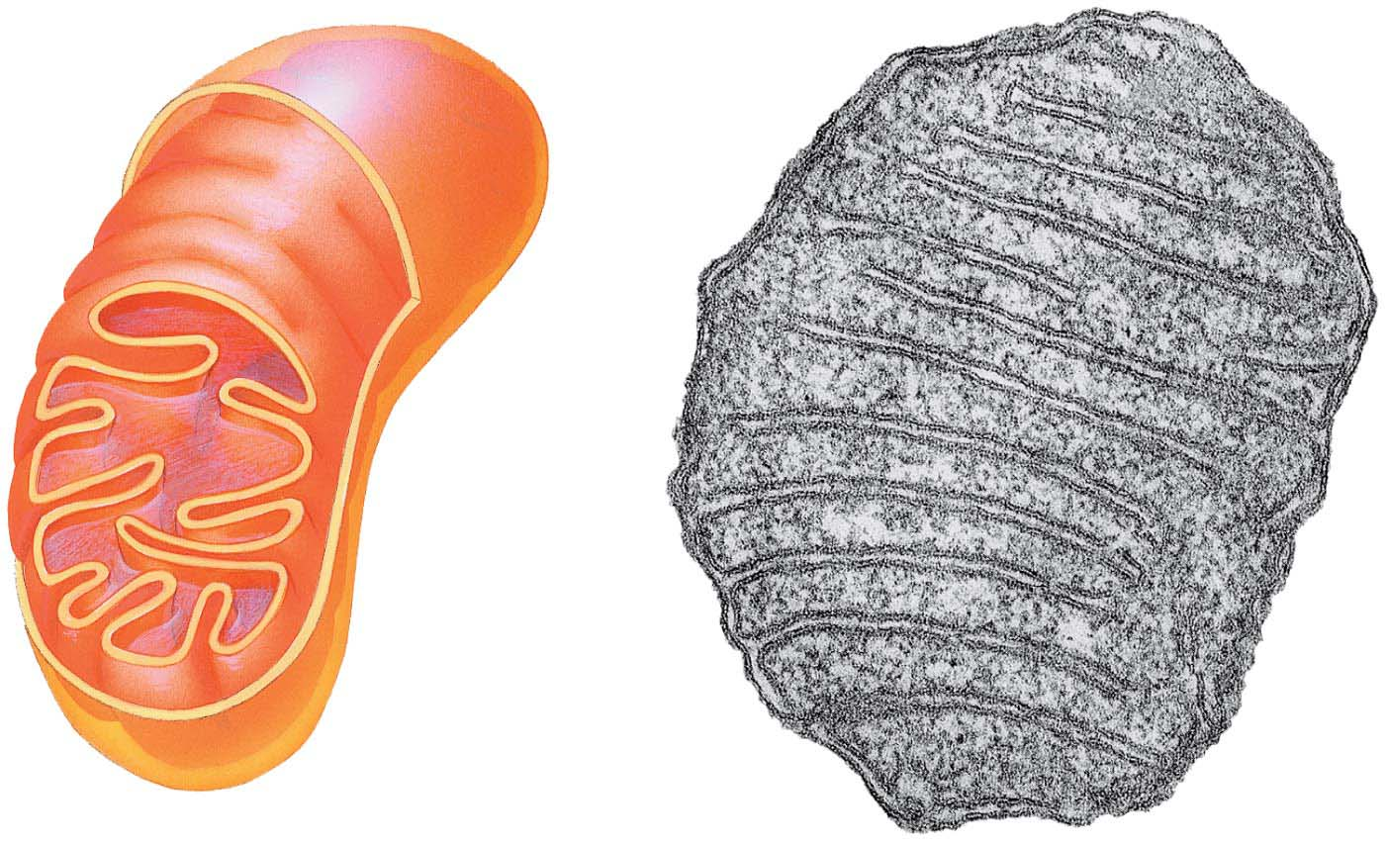
Figure 4.18
Outer
membrane
TEM
Inner
membrane
Cristae
Matrix
Space between
membranes
Notes:
Figure 4.18 The mitochondrion: site of cellular respiration

Slide 44
Stage 3: Electron Transport
The energy stored by electron transport behaves something like the water behind a dam.
There is a tendency for hydrogen ions to gush back to where they are less concentrated, just as there is a tendency for water to flow downhill.
The inner membrane temporarily “dams” hydrogen ions.
Notes:
44

Slide 45
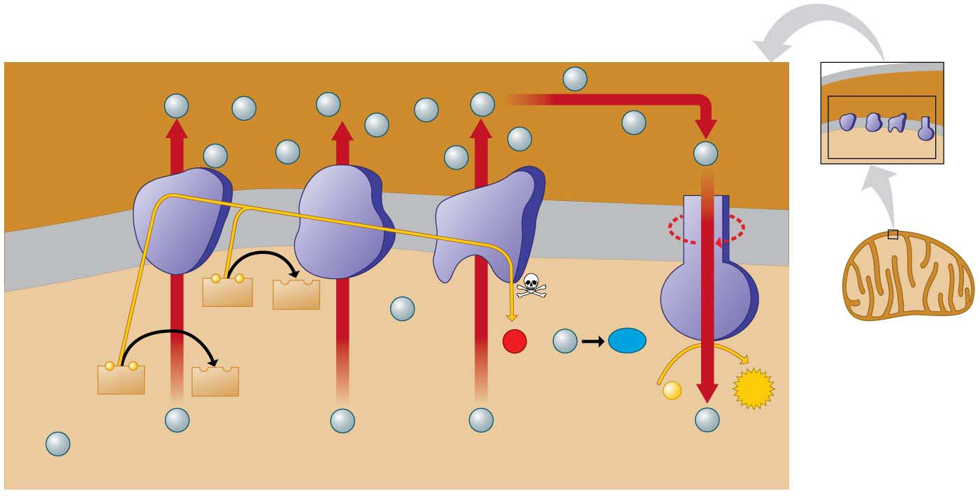
How electron transport drives ATP synthase machines
Space
between
membranes
H⁺
H⁺
H⁺
H⁺
H⁺
H⁺
H⁺
Electron
carrier
H⁺
H⁺
H⁺
3
H⁺
H⁺
Protein
complex
H⁺
H⁺
5
Inner
mitochondrial
membrane
−
−
FADH₂
FAD
Electron
flow
2
H⁺
1
H₂O
O₂
H⁺
6
2
2
−
−
4
NADH
NAD⁺
+
ATP
ADP
P
1
H⁺
H⁺
H⁺
H⁺
H⁺
Matrix
Electron transport chain
ATP synthase
Notes:
Figure 6.10 How electron transport drives ATP synthase machines

Slide 46
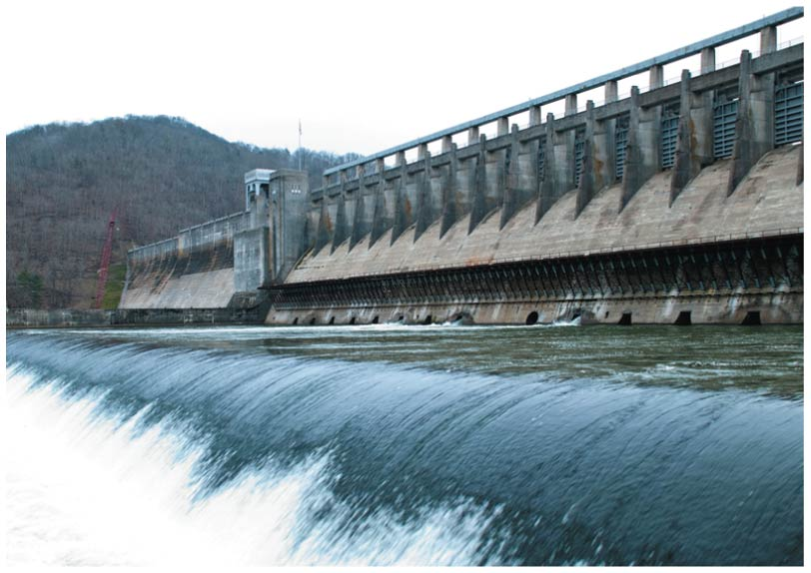
Notes:
Figure 6.10-2 How electron transport drives ATP synthase machines (part 2: dam)

Slide 47
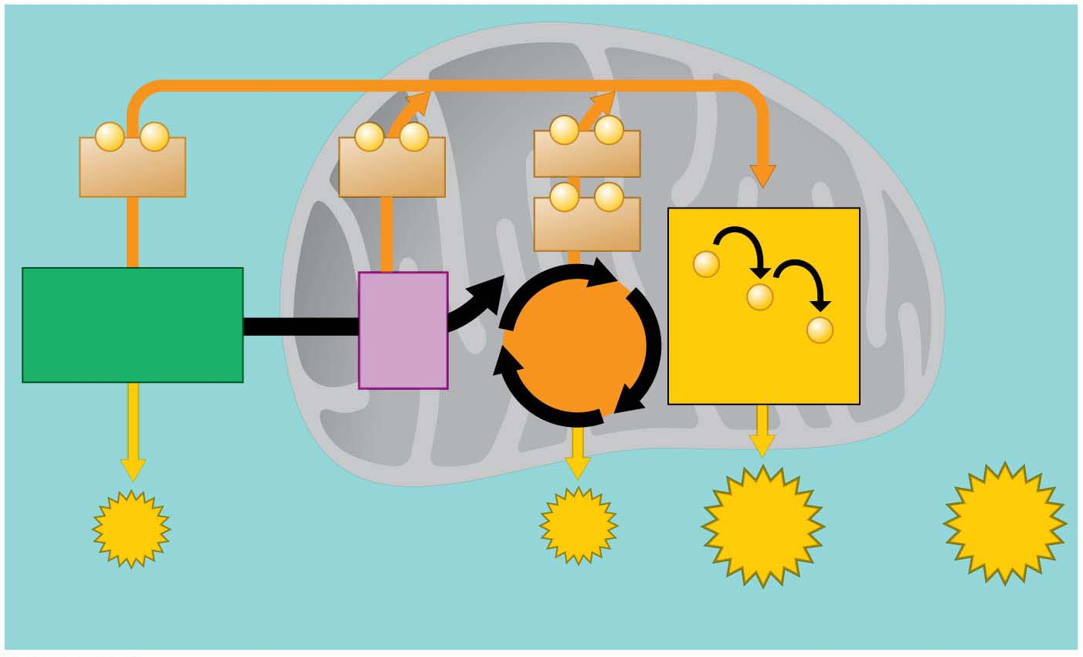
A summary of ATP yield during cellular respiration
Cytoplasm
Mitochondrion
−
−
−
−
−
−
2
NADH
2
NADH
6
NADH
−
−
2
FADH₂
−
Glycolysis
2
Acetyl
CoA
−
2
Pyruvic
acid
Citric
Acid
Cycle
−
Glucose
Electron
Transport Chain
Maximum
per
glucose:
2
ATP
2
ATP
About
28 ATP
About
32 ATP
by direct
synthesis
by direct
synthesis
by ATP
synthase
Notes:
Figure 6.11 A summary of ATP yield during cellular respiration

Slide 48
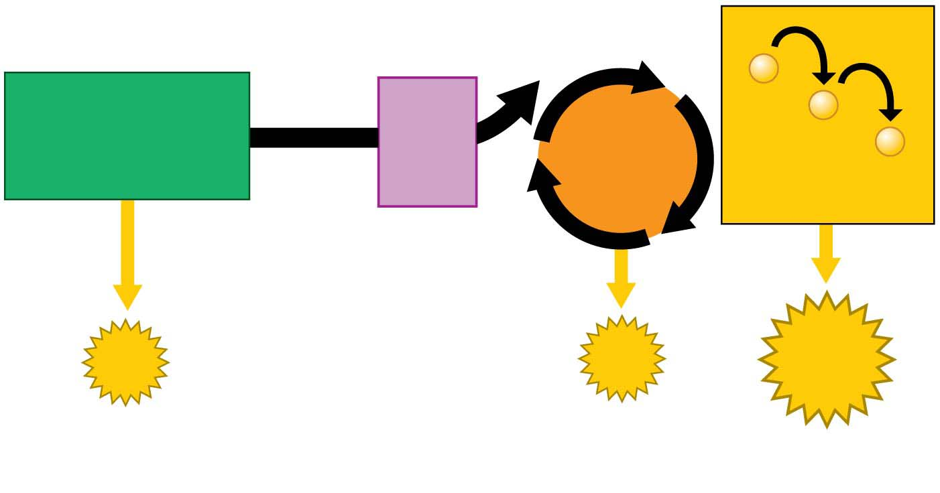
Figure 6.11-1
−
Glycolysis
2
Acetyl
CoA
−
2
Pyruvic
acid
Citric
Acid
Cycle
−
Glucose
Electron
Transport Chain
2
ATP
2
ATP
About
28 ATP
by direct
synthesis
by direct
synthesis
by ATP
synthase
Notes:
Figure 6.11-1 A summary of ATP yield during cellular respiration (part 1: detail)

Slide 49
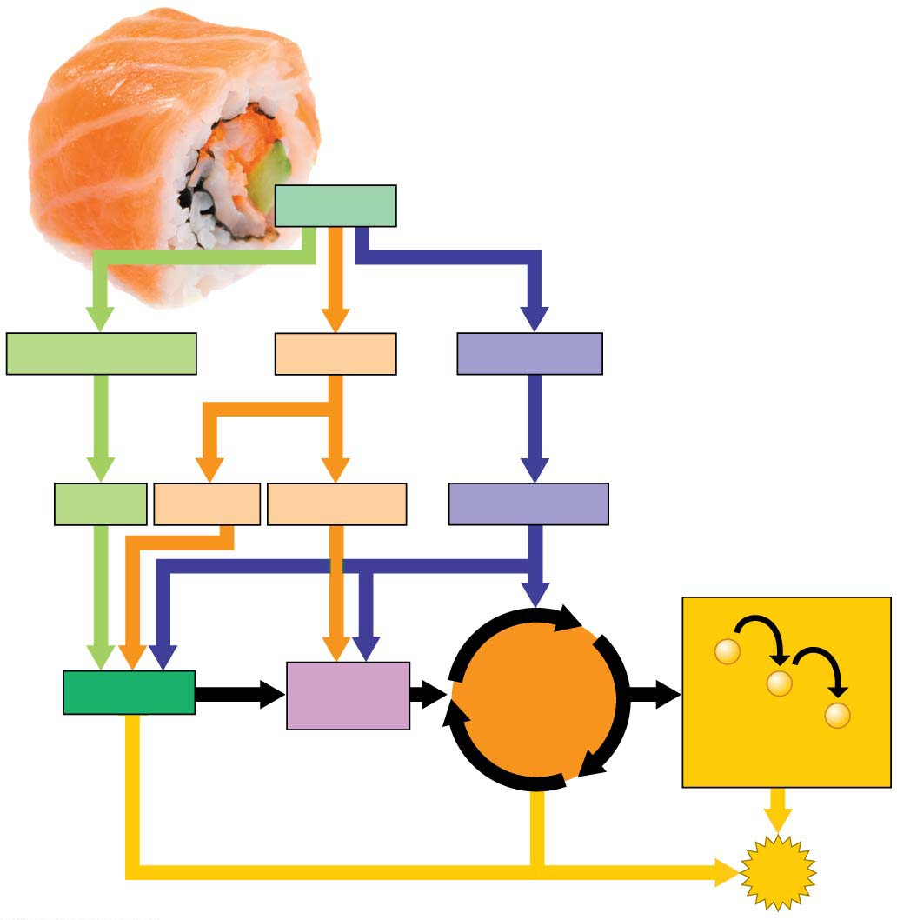
Energy from food
Food
Carbohydrates
Fats
Proteins
Sugars
Glycerol
Fatty acids
Amino acids
−
Glycolysis
Acetyl
CoA
Citric
Acid
Cycle
−
−
Electron
Transport Chain
ATP
Notes:
Figure 6.12 Energy from food

Slide 50
Fermentation（发酵）: Anaerobic Harvest of Food Energy
Some of your cells can actually work for short periods without oxygen.
Fermentation is the anaerobic (without oxygen) harvest of food energy.
Notes:
50

Slide 51
Fermentation in Human Muscle Cells
After functioning anaerobically for about 15 seconds, muscle cells begin to generate ATP by the process of fermentation.
Fermentation relies on glycolysis to produce ATP.
Glycolysis
does not require oxygen and
produces two ATP molecules for each glucose broken down to pyruvic acid.
Notes:
51

Slide 52
Fermentation in Human Muscle Cells
To harvest food energy during glycolysis, NAD⁺ must be present to receive electrons.
This is no problem under aerobic conditions, because the cell regenerates NAD⁺ when NADH drops its electron cargo down electron transport chains to O₂.
Notes:
52

Slide 53
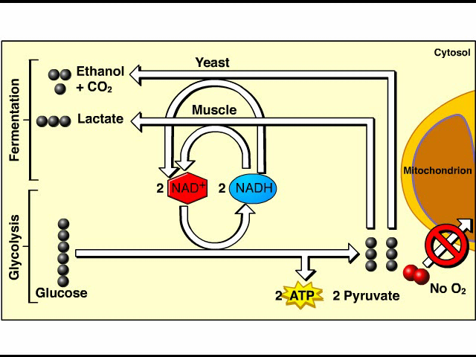
Animation: Fermentation Overview

Slide 54
Figure 6.9
e⁻
e⁻
Electrons from food
NAD⁺
e–
e–
NAD⁺
NADH
Stepwise release
of energy used
to make ATP
ATP
2
e⁻
−
−
Electron
transport
chain
2
e⁻
1
O₂
2
H₂O
Hydrogens,
electrons, and
oxygen combine to
form water
2
H⁺
Notes:
Figure 6.9 The role of oxygen in harvesting food energy

Slide 55
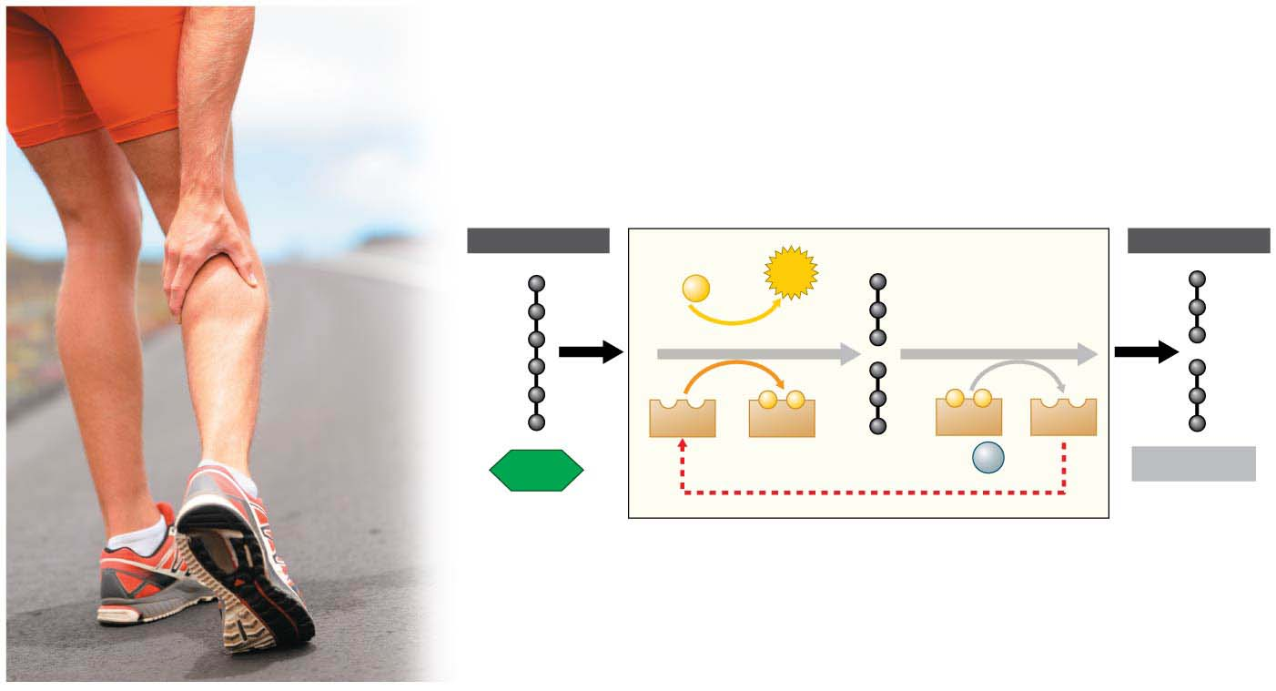
Figure 6.13
INPUT
OUTPUT
INPUT
2 ADP
2
ATP
+ 2
P
Glycolysis
−
−
−
−
2
NAD⁺
2
NADH
2
NADH
2
NAD⁺
2 pyruvic
acid
+ 2
H⁺
2 lactic acid
Glucose
Notes:
Figure 6.13 Fermentation: producing lactic acid

Slide 56
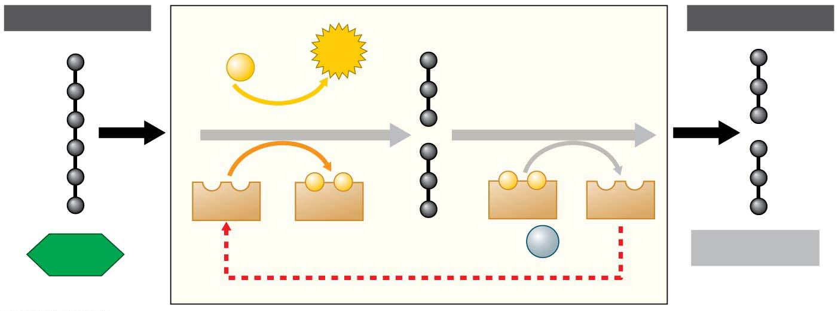
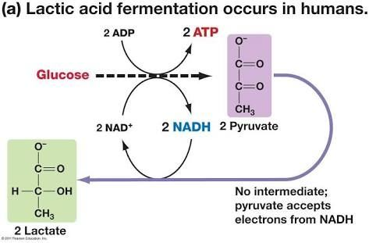
Figure 6.13-1
INPUT
OUTPUT
2 ADP
2
ATP
+ 2
P
Glycolysis
−
−
−
−
2
NAD⁺
2
NADH
2
NADH
2
NAD⁺
2 pyruvic
acid
+ 2
H⁺
2 lactic acid
Glucose
Notes:
Figure 6.13-1 Fermentation: producing lactic acid (part 1: detail)

Slide 57
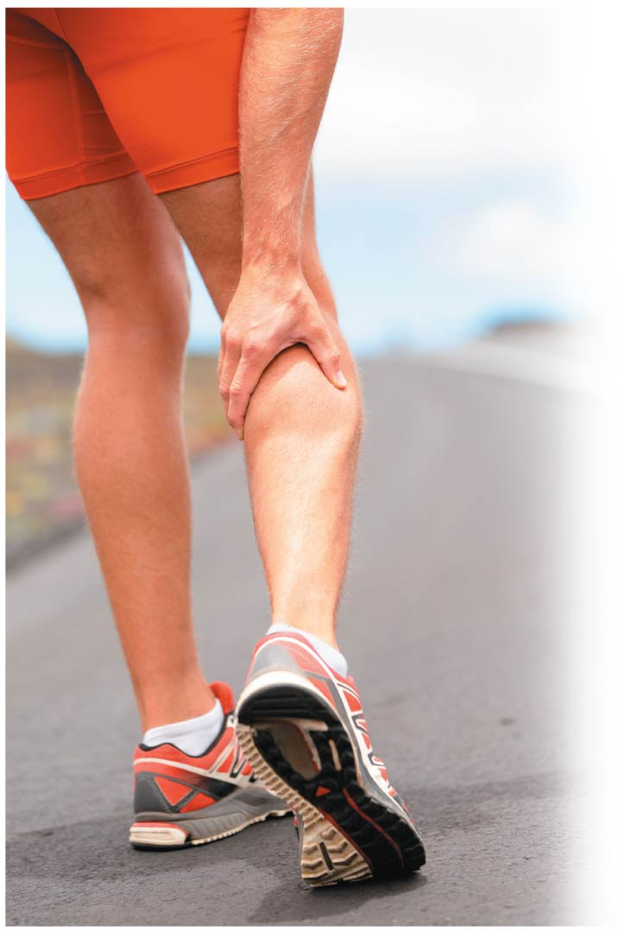
Figure 6.13-2
Notes:
Figure 6.13-2 Fermentation: producing lactic acid (part 2: runner's legs)

Slide 58
The Process of Science: What Causes Muscle Burn?
Observation: Muscles produce lactic acid under anaerobic conditions.
Question: Does the buildup of lactic acid cause muscle fatigue（肌肉疲劳）?
Notes:
58

Slide 59
The Process of Science: What Causes Muscle Burn?
Hypothesis: The buildup of lactic acid would cause muscle activity to stop.
Experiment: Researchers tested frog muscles under conditions when lactic acid could and could not diffuse away from the muscle tissue.
Notes:
59

Slide 60
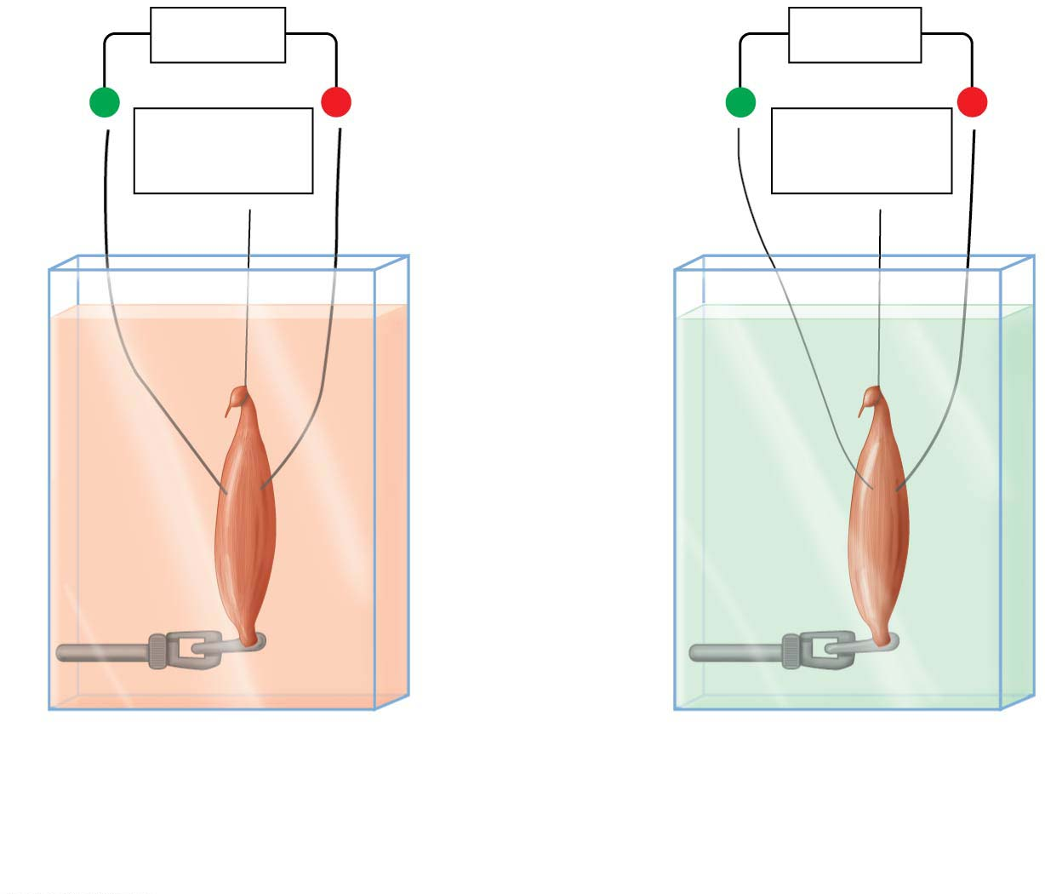
Figure 6.14
Battery
Battery
+
−
+
−
Force
measured
Force
measured
Frog
muscle
stimulated
by electric
current
Solution prevents
diffusion of lactic acid
Solution allows
diffusion of lactic acid;
muscle can work for
twice as long
Notes:
Figure 6.14 A. V. Hill’s 1929 apparatus for measuring muscle fatigue

Slide 61
The Process of Science: What Causes Muscle Burn?
Results: When lactic acid was allowed to diffuse away, performance improved significantly.
Conclusion: The buildup of lactic acid is the primary cause of muscle failure under anaerobic conditions.
However, recent evidence suggests that the role of lactic acid in muscle function remains unclear.
Notes:
61

Slide 62
The Process of Science: What Causes Muscle Burn?
Evidence began to accumulate that contradicted Hill’s results.
The effect that Hill demonstrated did not appear to occur at human body temperature.
Further, certain individuals who are unable to accumulate lactic acid have muscles that fatigue more rapidly, the opposite of what is expected.
Notes:
62

Slide 63
The Process of Science: What Causes Muscle Burn?
Recent research indicates that increased levels of other ions may be to blame.
The role of lactic acid in muscle fatigue remains a hotly debated topic.
Science is dynamic and subject to constant adjustment as new evidence is uncovered.
Notes:
63

Slide 64
Fermentation in Microorganisms
Fermentation alone is enough to sustain many microorganisms.
The lactic acid produced by yeast（酵母） using lactic acid fermentation is used to produce
cheese, sour cream, and yogurt,
soy sauce, pickles, cabbage, and olives, and
sausage meat products.
Notes:
64

Slide 65
Fermentation in Microorganisms
Yeast
is capable of cellular respiration and fermentation and
can perform alcoholic fermentation to produce CO₂ and ethyl alcohol instead of lactic acid.
For thousands of years, people have put yeast to work producing alcoholic beverages such as beer and wine.
As every baker knows, the CO₂ bubbles from fermenting yeast also cause bread dough to rise.
Notes:
65

Slide 66
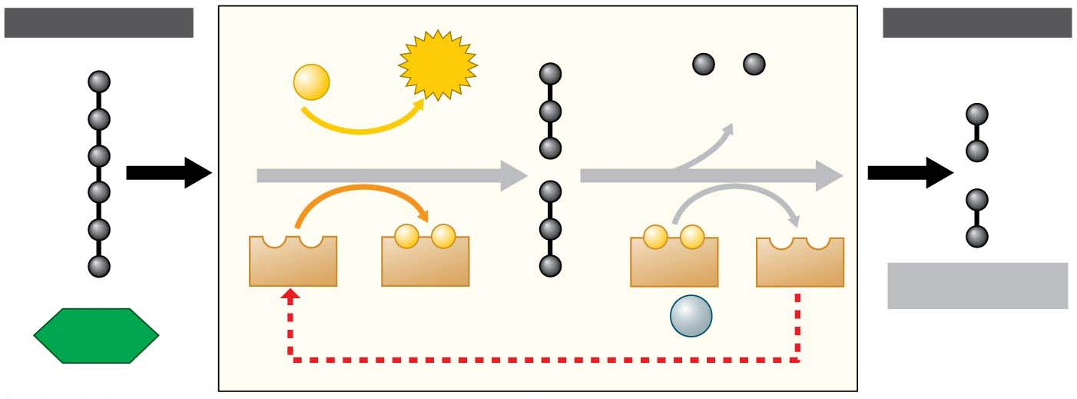
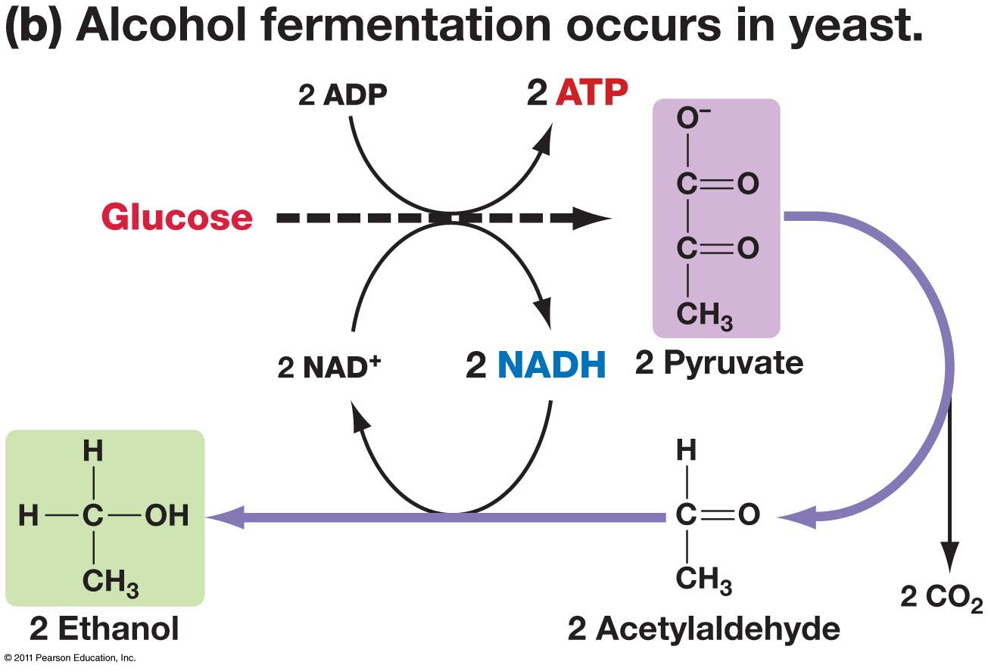
Figure 6.15
INPUT
OUTPUT
2 ADP
2
ATP
+ 2
P
P
2 CO₂ released
Glycolysis
−
−
−
−
2
NAD⁺
2
NADH
2
NADH
2
NAD⁺
2 Ethyl alcohol
2 pyruvic acid
+ 2
H⁺
Glucose
(2 Ethanol)
Notes:
Figure 6.15 Fermentation: producing ethyl alcohol

Slide 67
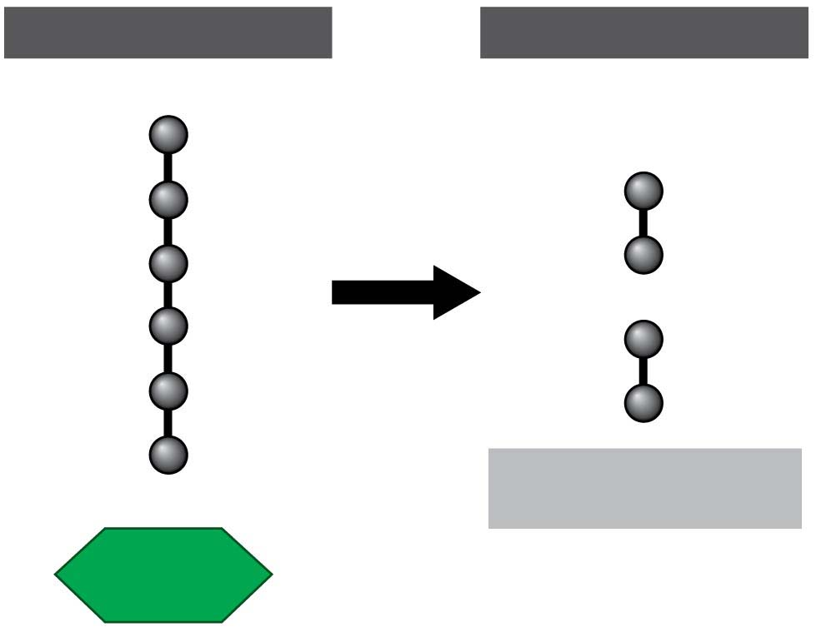
Figure 6.15-1
INPUT
OUTPUT
2 Ethyl alcohol
Glucose
Notes:
Figure 6.15-1 Fermentation: producing ethyl alcohol (part 1: input and output)

Slide 68
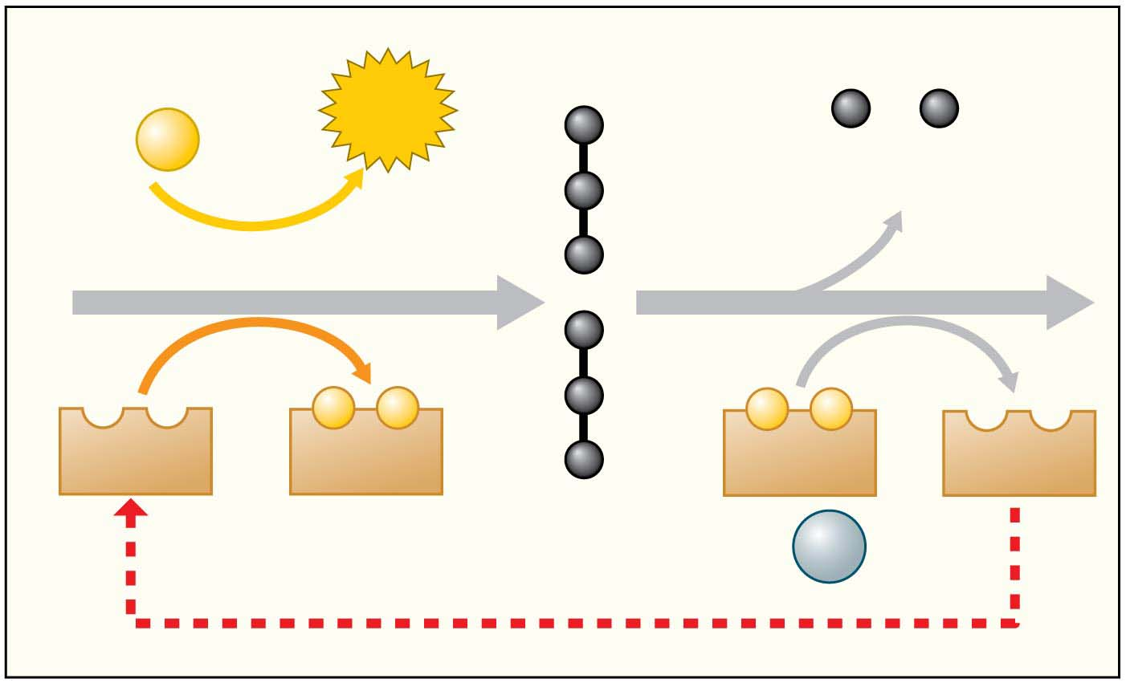
Figure 6.15-2
2 ADP
2
ATP
+ 2
P
P
2 CO₂ released
Glycolysis
Glucose
−
−
−
−
2
NAD⁺
2
NADH
2
NADH
2
NAD⁺
2 pyruvic acid
+ 2
H⁺
Notes:
Figure 6.15-2 Fermentation: producing ethyl alcohol (part 2: steps)

Slide 69
Evolution Connection: The Importance of Oxygen
Aerobic and anaerobic respiration start with glycolysis, the splitting of glucose to form pyruvic acid.
Glycolysis is thus the universal energy-harvesting process of life.
The role of glycolysis in both respiration and fermentation has an evolutionary basis.
Between 3.5 and 2.7 billion years ago, before significant levels of oxygen were present in Earth’s atmosphere, ancient prokaryotes probably
used glycolysis to make ATP and
generated ATP exclusively from glycolysis.
Notes:
69

Slide 70
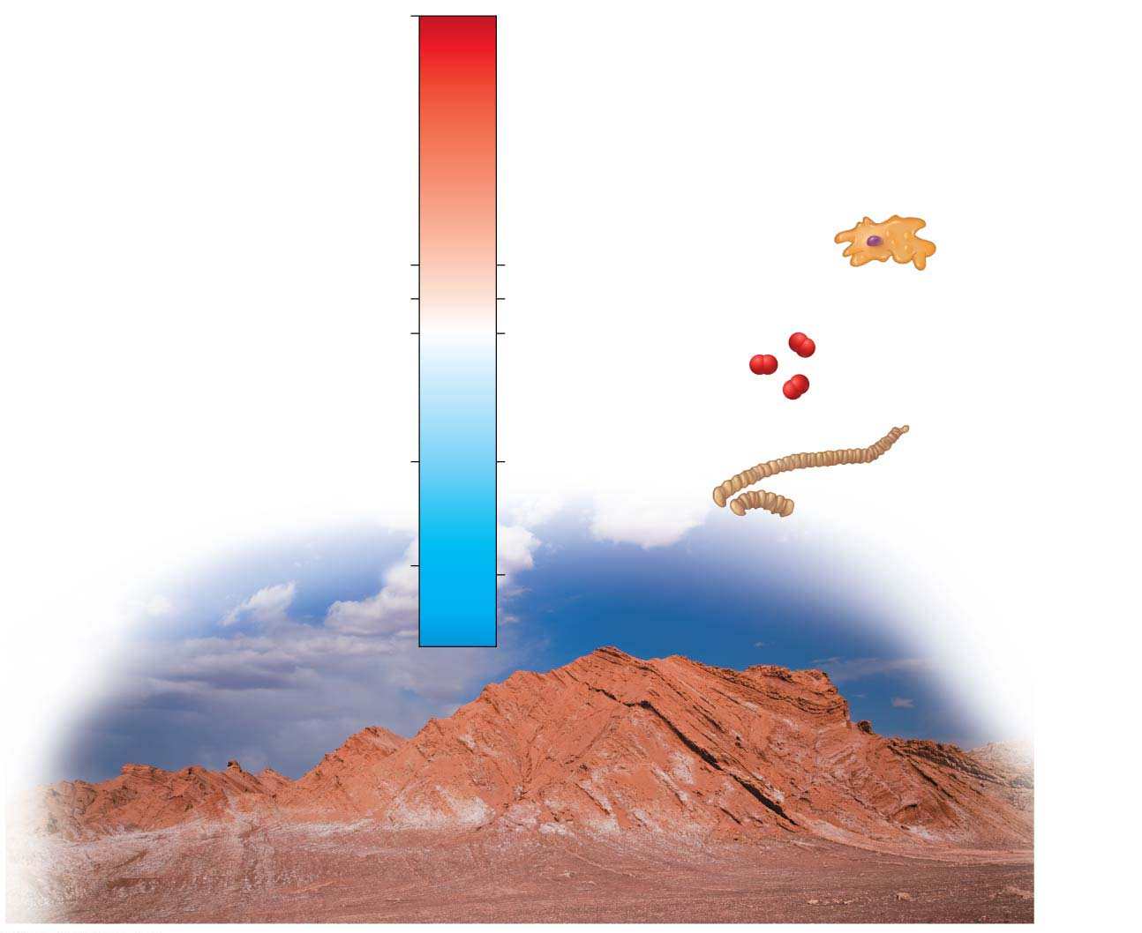
0
O₂ present in
Earth’s atmosphere
2.1
First eukaryotic organisms
2.2
Atmospheric oxygen reaches 10% of modern levels
2.7
Atmospheric oxygen
first appears
Billions of years ago
3.5
Oldest prokaryotic
fossils
4.5
Origin of Earth
Notes:
Figure 6.16 A time line of oxygen and life on Earth

Slide 71
Evolution Connection: The Importance of Oxygen
The fact that glycolysis occurs in almost all organisms suggests that it evolved very early in ancestors common to all the domains of life.
The location of glycolysis within the cell also implies great antiquity.
The pathway does not require any of the membrane-enclosed organelles of the eukaryotic cell, which evolved more than a billion years after the prokaryotic cell.
Notes:
71

Slide 72
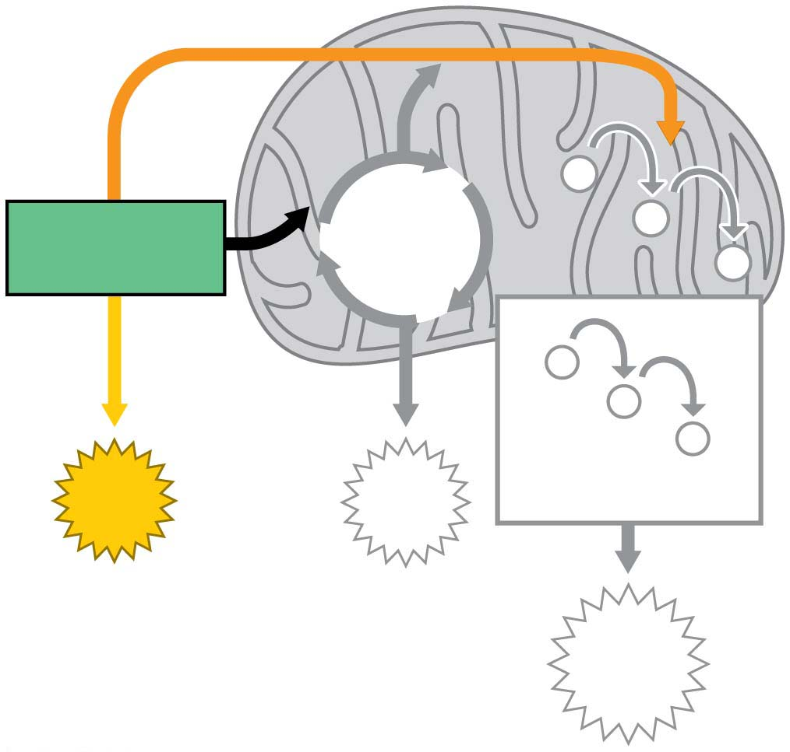
−
Citric
Acid
Cycle
−
Glycolysis
−
−
−
−
Electron
Transport Chain
ATP
ATP
ATP
Notes:
Figure 6.UN01 In-text figure, glycolysis, p. 96

Slide 73
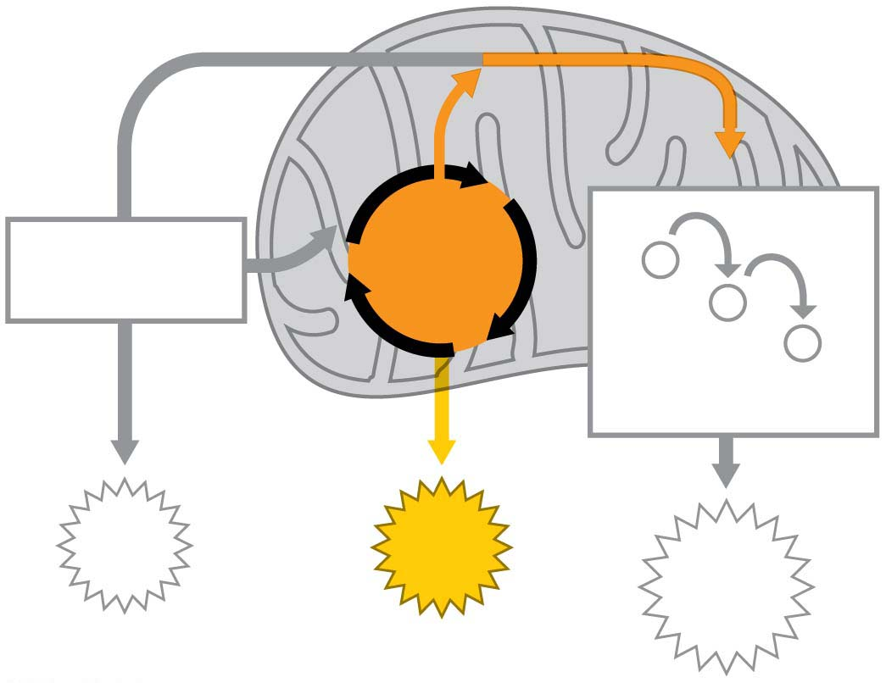
Figure 6.UN02
Citric
Acid
Cycle
Glycolysis
−
−
−
Electron
Transport Chain
ATP
ATP
ATP
Notes:
Figure 6.UN02 In-text figure, citric acid cycle, p. 97

Slide 74
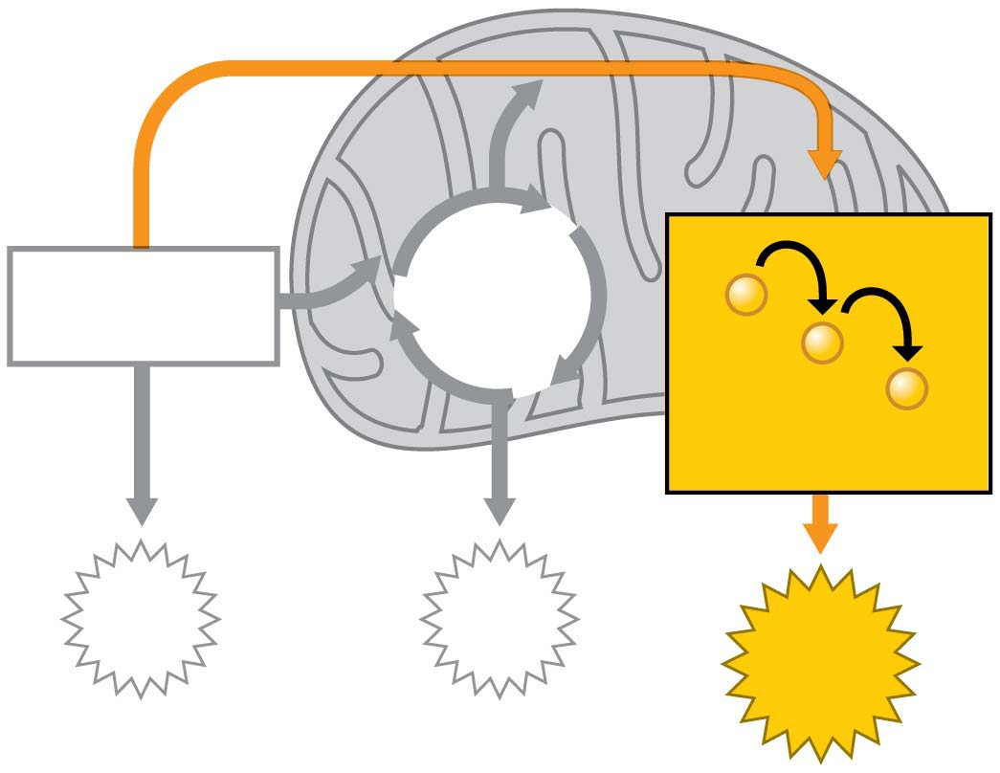
Figure 6.UN03
Citric
Acid
Cycle
Glycolysis
−
−
−
Electron
Transport Chain
ATP
ATP
ATP
Notes:
Figure 6.UN03 In-text figure, electron transport chain, p. 98

Slide 75
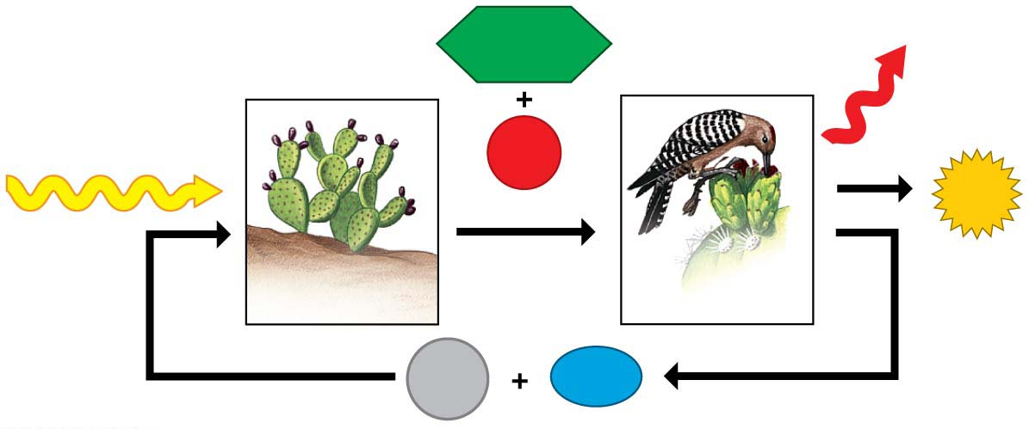
Figure 6.UN04
Heat
C₆H₁₂O₆
Sunlight
O₂
ATP
Photosynthesis
Cellular
respiration
CO₂
H₂O
Notes:
Figure 6.UN04 Summary of key concepts: chemical cycling

Slide 76
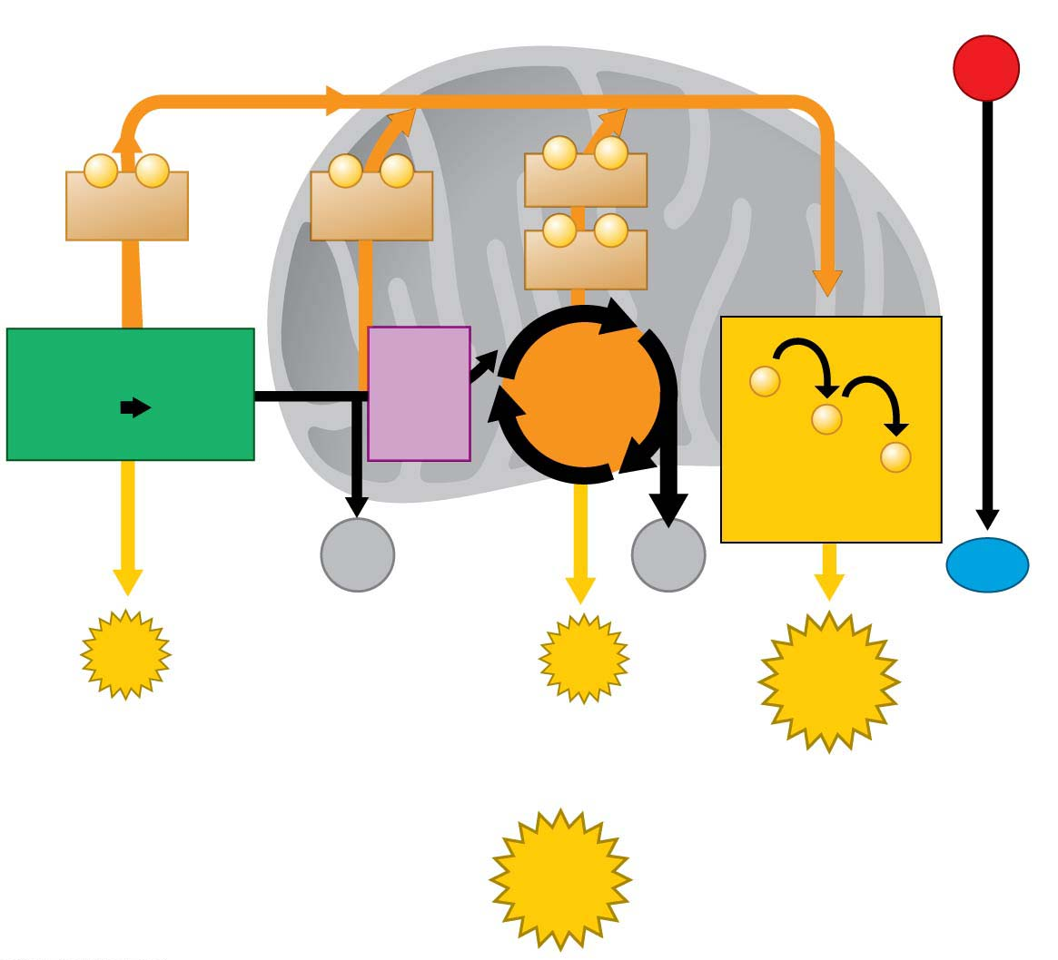
Figure 6.UN06
Mitochondrion
O₂
−
−
−
−
−
−
6
NADH
2
NADH
2
NADH
−
−
2
FADH₂
Glycolysis₂
2
Acetyl
CoA
Citric
Acid
Cycle
−
Glucose
Pyruvic
acid
−
−
Electron
Transport Chain
2
CO₂
4
CO₂
H₂O
2
ATP
by direct
synthesis
by direct
synthesis
2
ATP
by ATP
synthase
About
28 ATP
About
32 ATP
Notes:
Figure 6.UN06 Summary of key concepts: cellular respiration results

Slide 77
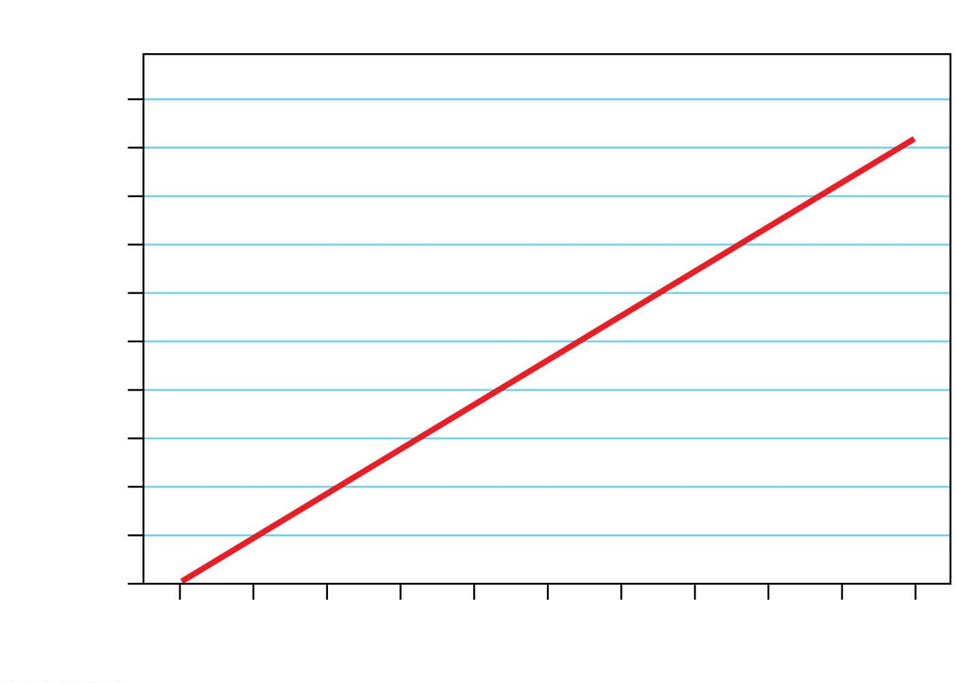
Figure 6.UN07
BMR by weight
2100
2050
2000
1950
1900
BMR (calories)
1850
1800
1750
1700
1650
1600
150
160
170
180
190
200
210
220
230
240
250
Pounds
Notes:
Figure 6.UN07 Process of science, question 12 (BMR)

